Slide 1
INNOVATIVE SOLUTIONS
TO ADDRESS THE XYLAZINE CRISIS
IN PHILADELPHIA
Nov 2023

Slide 2
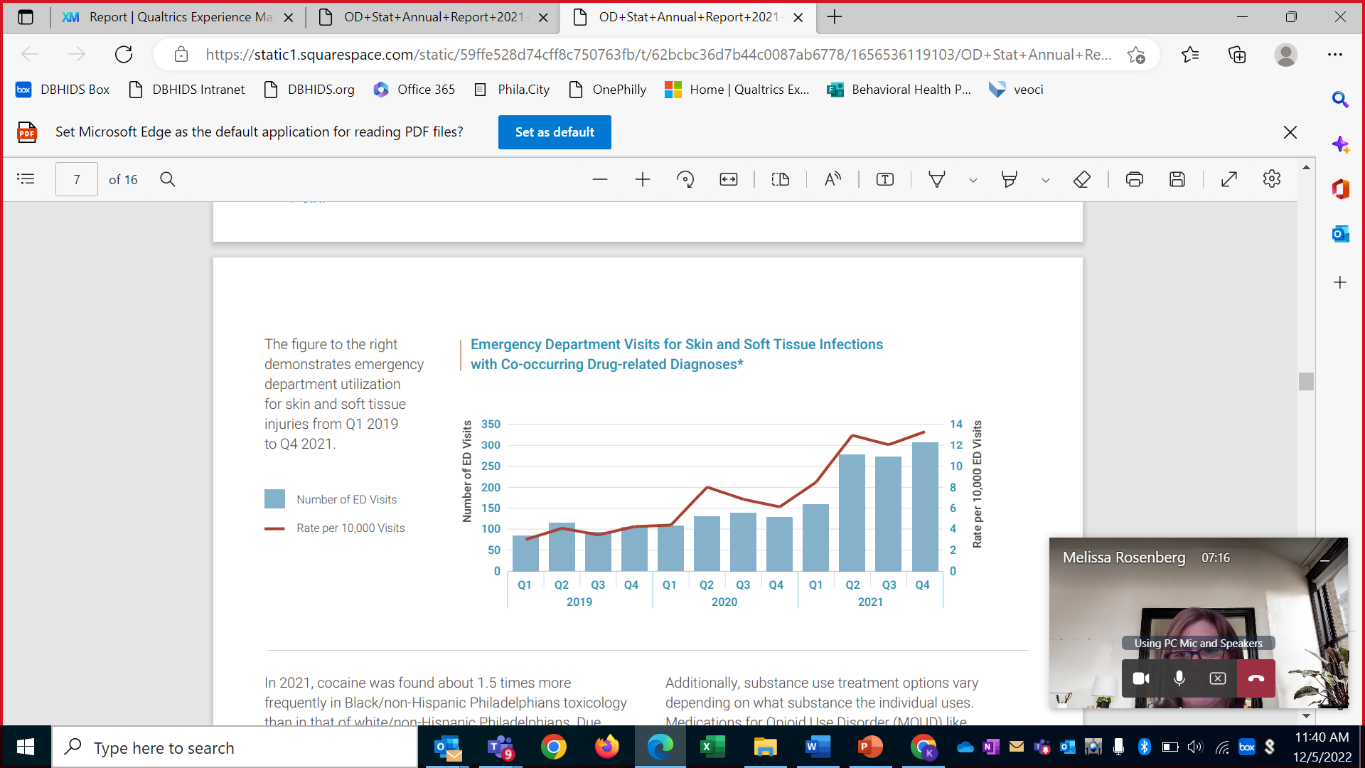


Individuals with infective endocarditis related to drug use typically:
are younger
have higher rates of smoking, drinking and liver disease
are more likely to need emergency surgery
are on Medicaid or uninsured
are at higher odds of major morbidity and in-hospital mortality
experience poorer long-term outcomes
experience significantly longer hospital stays
NATIONALLY
2 in every 3 persons with injection drug use (PWID) have had a wound or an abscess due to injection drug use (2021)
PHILADELPHIA
Approximately 1 in every 3 individuals in Philadelphia experiencing homelessness (sheltered and unsheltered) also experience SUD
From 2019 to 2021, Philadelphia saw skin and soft tissue infections nearly quadrupled, likely connected to xylazine’s rise.
Notes:
National Statistic: One out of every three individuals experiencing SUD will develop complex wounds including abscesses at injection sites, sores, and open wounds within a 1-year period.
Cahn, B. A., Bartholomew, T. S., Patel, H. P., Pastar, I., Tookes, H. E., & Lev-Tov, H. (2021). Correlates of injection-related wounds and skin infections amongst persons who inject drugs and use a syringe service programme: A single center study. International wound journal, 18(5), 701–707. https://doi.org/10.1111/iwj.13572https://www.ncbi.nlm.nih.gov/pmc/articles/PMC8450795/
Approximately 1 in every 3 (29.3%) individuals in Philadelphia experiencing homelessness (sheltered and unsheltered) also experience SUD
– based on the HUD 2022 Continuum of Care Homeless Assistance Programs Homeless Populations and Subpopulations, FY 2022 Point-in-Time
CoC_PopSub_CoC_PA-500-2022_PA_2022.pdf (hudexchange.info) https://files.hudexchange.info/reports/published/CoC_PopSub_CoC_PA-500-2022_PA_2022.pdf
Graph: With the increase of xylazine in the Philadelphia area, the types of wounds seen in the medical community have presented as even more complex with a 5% increase in SST infections and a 20+% increase in bone osteomyelitis between 2019 and 2020, Wounds related to xylazine often require oral or IV antibiotics for weeks.
Philadelphia OD Stat Overdose Fatality Review 2021
Information in Blue Box: Individuals experiencing SUD are vulnerable- typically uninsured or underinsured and experiencing higher rates of homelessness. This population experiences higher rates of endocarditis, osteomyelitis, Rhabdomyolysis, abscesses, and bacteremia as well as poorer long-term outcomes.
Drug use impacts the care required by patients with infective endocarditis - Mayo Clinic November 26, 2020. https//www.mayoclinic.org/medical-professionals/cardiovascular-diseases/news/drug-use-impacts-the-care-required-by-patients-with-infective-endocarditis/mac-20504365

Slide 3
Innovative Solution #1
Mobile Wound Care Vans
May 2022 – January 2023
August 2023

Slide 4
Model: Mobile Wound Care Van
Staffing
Driver
Services
Treat Level 1-4 wounds
Model
Monday-Friday from 8:00AM-4:00PM
The Rock Ministries on 2700 Kensington Avenue
Recognized by the yellow Kensington Hospital tent set up next to the van
Medical Doctor
Specialized wound-care Nurse
Social Worker/Behavioral Health Intake Worker
Working toward expansion
Provide knowledge, advice, and assistance to patients regarding treatment
Transport to Detox and/or Rehab
Transport patients to same day medical appointments
Dental infections
Scabies

Slide 5
May 16, 2022-January 27, 2023 (256 days)
Mobile Wound Care Van Program Outcomes
1,254
total patients seen
697
total # of prescriptions given
16
total # of patients transferred to ER
7
total # of dental abscesses treated
7
total # suboxone inductions
13
total # new Medical clinic patients
14
total # of scabies treatment provided
6
total # Narcan doses given
2,129
Total # of wounds treated (all dressed)

Slide 6
Mobile Wound Care Van Cost Savings
Assuming a minimum of 1238 individuals treated would have sought treatment in the ED.
Assuming a $340 cost savings per individual
Results in a savings in
< 9mo of $420,920
Wound Care Van
$173 per visit
Emergency Department
$513 per visit
vs.

Slide 7
Innovative Solution #2
City of Philadelphia - Kensington
100 Day Challenge
August 2023

Slide 8
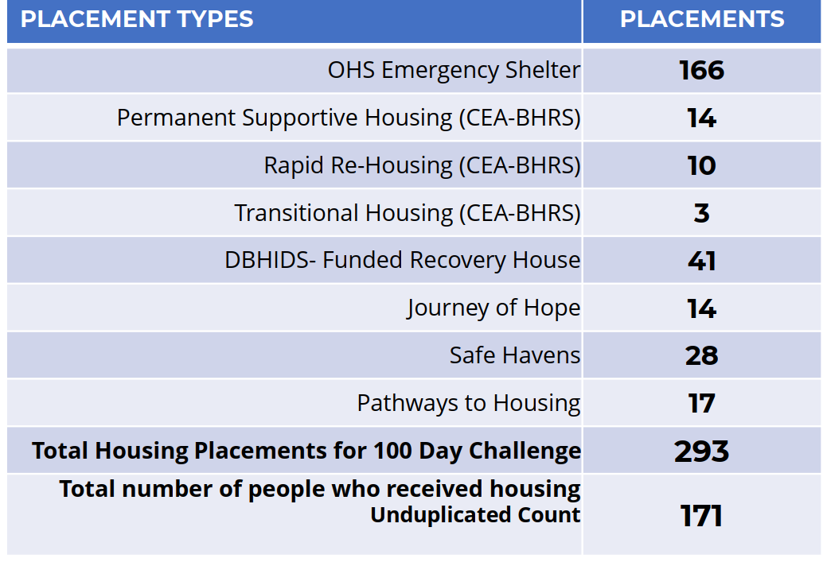
100 Day Challenge Outcomes
TIME PERIOD: March 28, 2022 to July 5, 2022
GOAL: Place 350 unique individuals in either a housing or treatment option funded through the City of Philadelphia in 100 days
LOCATION: 5 zip codes that make up Kensington
WHO: Unsheltered individuals who have either been seen by an outreach worker more than twice and/or have been placed in the three specific shelters (Ife Wellness, ODAAT Encampment Respite, and Beacon House)

Slide 9
One of the primary barriers in placing individuals with SUD during the 100 Day Challenge was open wounds due to Xylazine.
Notes:
Innovative Solutions would be needed to combat this barrier including two we will discuss today: Mobile Wound Care Van Programs and the L4 Post Acute Care Program.

Slide 10
Innovative Solution #3
The Philly Model: ASAM Level 4 Post Acute Care
(L4PA Program)
August 2023

Slide 11
CASE EXAMPLES
62-year-old female
Diagnoses:
Polysubstance Use Disorder (cocaine + heroin)
Multiple toe amputations
Wounds status post (s/p) multiple surgeries
Medications: Pain medications and medications for opioid use disorder (MOUD)
Post-Acute Treatment: Wound care every other day
Length of Stay (LOS): 27 days
BARRIERS FOR DISCHARGE:
Recent incarceration
Experiencing homelessness
Polysubstance use on admission
34-year-old male
Diagnoses:
History of IV Fentanyl use
Bacteremia endocarditis
Medications: Chronic Methadone
Post-Acute Treatment: 6 weeks IV antibiotics via peripherally inserted central catheter (PICC) line
Length of Stay (LOS): 46 days
BARRIERS FOR DISCHARGE:
Experiencing homelessness
Substance use disorder
Notes:
These individuals were forced to complete their wound care and antibiotics in the physical health acute care setting where no psychiatric or rehabilitation services were offered during the 4-6 weeks these individuals were in the hospital, i.e., CBT, CRS
We also know that in these settings more than 40% of individuals with SUD use substances during their hospital stay
https://www.ncbi.nlm.nih.gov/pmc/articles/PMC9897266/#:~:text=More%20than%2040%25%20of%20individuals,to%20use)%2C%20and%20stigma.

Slide 12

CRITICAL SUCCESS FACTORS
Medical Operations Coordination Cell – modified
Learning Communities
Implementation Science EPIS Framework
Crisis requiring load-balancing-like leadership across facilities and systems within provider, payer, public health and governmental agencies
Stakeholders with shared concern seeking to deepen understanding through learning in action while grappling with real-life questions
Evidence-based strategies to facilitate exploration, adoption, implementation and sustainment
Notes:
A crisis deserves to be addressed using the most relevant approach possible.
An innovative approach
best practice structure from emergency management with modifications (MOCC)
learning communities with Tiger Teams across providers (CBPR)
Principles of implementation science for rapid adaptation (EPIS)
MOCC: United States Health and Human Services Administration for Strategic Preparedness and Response’s (ASPR) Medical Operations Coordination Center Model provides a framework for regional coordination with key stakeholders to ‘load-balance’ urgent care needed by a vulnerable populations during a disaster (HHS.gov). MOCC can be configured in a single existing organization or convened as a shared entity by stakeholders in the defined geography. Patient load-balancing includes pre-hospital, hospital and post-hospital distribution of patients to optimize capacity at all levels through collaborative functions. MOCC was utilized in local, regional and national initiatives during the COVID 19 pandemic with documented benefits of improved capacity management, expanded information sharing, reduces workforce friction, and reduced variation in approaches to care (ASPR TRACIE, 2021 https://files.asprtracie.hhs.gov/documents/fema-mocc-toolkit.pdf)
The participatory-cooperative paradigm of Community-Based Participatory Research (CBPR) provides the Learning Community framework to increase and integrate knowledge and understanding of a phenomenon leading to interventions that include policy and social change to improve health and quality of life for the community. The National Institute on Minority and Health Disparities utilizes CBPR to address improved transdisciplinary and intervention approaches and to strengthen the science of community engagement both to address health disparities in socially disadvantaged populations. CBPR enhances community capacity by supporting broad and deep stakeholder participation, leads to sustainable improvement in health disparities and outcomes, and accelerates the translation of evidence and outcome findings to further inform program attributes .
Berge JM, Mendenhall TJ, Doherty WJ. Using Community-based Participatory Research (CBPR) To Target Health Disparities in Families. Fam Relat. 2009 Oct 1;58(4):475-488. doi: 10.1111/j.1741-3729.2009.00567.x. PMID: 20625444; PMCID: PMC2897175.
Munro, A., Shakeshaft, A. & Clifford, A. The development of a healing model of care for an Indigenous drug and alcohol residential rehabilitation service: a community-based participatory research approach. Health Justice 5, 12 (2017). https://doi.org/10.1186/s40352-017-0056-z
The Agency for Toxic Substances and Disease Registry underscores CBPR’s impact to assess, evaluate and disseminate effective approaches for individuals, communities and society. https://www.atsdr.cdc.gov/communityengagement/pce_models.html#figure3.
https://www.nimhd.nih.gov/programs/extramural/community-based-participatory.html#goals
Clinical innovation cannot impact care unless it is implemented and sustained. Community interventions can take time to develop in light of the dense engagement of stakeholders and the complexity of the system change that is required to address the post-acute needs for individuals with active addiction requiring IV antibiotics and wound care. In fact, as many as 50% of clinical innovations make it to practice (Bauer and Kirchner, 2020). Implementation science is a method to accelerate and promote evidence into practice to enhance quality, cost, access and workforce outcomes through systematic stakeholder engagement (Bauer and Kirchner, 2020). Implementation science methods can simultaneously tests the implementation strategy and the clinical outcomes in real time thereby mitigating risks, better informing decisions, maintaining high stakeholder engagement and optimizing the quality of outcomes. The Explore, Prepare, Implement and Sustain Framework is utilized to guide teams through the iterative journey from evidence to practice successfully that can enhance the speed to value of a CBPR initiative (Landes et al, 2019 need others)
Landes SJ, McBain SA, Curran GM. An introduction to effectiveness-implementation hybrid designs. Psychiatry Res. 2019 Oct;280:112513. doi: 10.1016/j.psychres.2019.112513. Epub 2019 Aug 9. PMID: 31434011; PMCID: PMC6779135.

Slide 13









Build trust through collaboration and partnership between acute care hospitals, ASAM level 4 providers, and the individual receiving treatment
Patient-driven with the strengths and needs of the individual determining the services and supports provided
Increase resource availability for individuals with SUD needing post-acute care and MOUD/MAT
Address stigma while treating all individuals with dignity, respect and compassion
Guiding Principles
Improve outcomes of individuals with SUD requiring post-acute care
Recovery encompasses all phases of care and is holistic, individualized, and utilizes harm-reduction interventions
Include perspectives of individuals with lived experience and individuals working as peer recovery specialists in the development of the program
Notes:
The Philadelphia Department of Behavioral Health and Intellectual Disabilities Services uses the strategic framework Prioritizing to Address Our Changing Environment (PACE) to address trauma, achieve equity and engage the community through individual and community-level interventions and, immediate and long-term strategies https://dbhids.org/about/organization/
DBHIDS is committed to TEC, the lens we use to prioritize our work:
Addressing Trauma – transform operations to be trauma-responsive and trauma-mitigating
Achieving Equity – transform systems to reduce behavioral health disparities and promote racial equity among Black, Indigenous and People of Color (BIPOC) by intentionally addressing structural and systemic racism
Engaging Community – shift services to become increasingly community based which will ensure long-term and sustained impacts of programs

Slide 14
Partnering for Program Development
City of Philadelphia: Department of Behavioral Health and Intellectual disAbility Services, Office of Homeless Services, Department of Public Health, Behavioral Health Special Initiative (BHSI)
Community Behavioral Health Medicaid Managed Care Organization
Physical Health Medicaid Managed Care Organizations (Keystone First/AmeriHealth Caritas, Health Partners Plans, Geisinger Health Plan, United Healthcare Community Plans, PA Health and Wellness)
Acute Care Hospitals
Behavioral Health Providers (ASAM Level 4 and Level 3.7 facilities, Warm Hand-off Program, Recovery Housing)
Individuals with lived experience
Community outreach stakeholders
Pennsylvania: Department of Health, Department of Human Services (OMHSAS), Department of Drug and Alcohol Programs
Notes:
Resources were identified in DBHIDS to work longitudinally across the system (rather than in the typical silos organizations are often limited to) to address the complex problem.
Every stakeholder group we met with had clearly recognized this barrier but had struggled to identify a systemic and sustainably funded solution.
Using the Learning Communities model, we met with the various stakeholder groups multiple times to ensure all potential barriers were addressed, clear lines of communication were established, and program requirements were realistic and supported the needs of the population.

Slide 15

Breakthrough Innovation
ASAM Level 4 programs are licensed acute care hospitals
ASAM Level 4 programs can provide high medical intensity services that can include IV antibiotics, Peripherally Inserted Central Catheter (PICC) care and advanced wound care:
Policies and procedures
Staff competencies
Supplies and equipment
Medical direction/oversight
Patients in active addiction but not requesting recovery can be offered the ability to access post acute IV therapy, PICC line care and wound care in the ASAM Level 4 setting:
Expert in MAT
Reachable moments
Completed medical care
Engagement in care plan
Notes:
BIG breakthrough - ASAM Level 4 programs are licensed acute care hospitals
As long as ASAM Level 4 providers have the required policies, procedures, competencies and resources they are fully capable to provide post acute IV therapy and wound care
Patients CAN BE offered recovery even in they have wounds!
AND – patients not seeking recovery can access ASAM Level 4 programs for post acute wound care for the benefit of expert medication management and access to behavioral health care as long as they are willing to participate with their treatment team. They do not have to be agreeable to go to group therapy right away nor do they have to agree to continue in recovery after discharge.

Slide 16
Eligibility Criteria
Individuals must meet the following criteria upon discharge from Philadelphia acute care hospital:
Age: 18 years or older
Insurance: CBH-eligible or uninsured (including undocumented)
ASAM Level of Care Assessment indicates Level 4 Program needed
Medical History:
  Medically stable, experiencing active SUD and requiring 2-12 weeks of post-acute care for IV antibiotics, wound care, and/or pain management
  Induction of MOUD/Medication-Assisted Treatment (MAT) in acute care setting for active SUD as needed
  Able to ambulate with or without assistive devices and able to take self to bathroom (self transfer from wheelchair)
Discharge Disposition: Individual would be able to go home with assistance from home health nurses and/or family if not for their SUD
Be willing to engage with treatment team and follow all L4 policies and procedures
*Individuals under court supervision would not be excluded from the program – standard protocol for inclusion would occur
Notes:
Prior to this program, there were no options for discharging this population from the hospital for post-acute care and rehabilitation services. This population generally was not admitted to skilled nursing facilities due to their SUD and the L4 rehabilitation programs were not able to accept them due to their physical health needs – IV antibiotics and sever wound care.
Highlight
Discharge Disposition: Individual would be able to go home with assistance from home health nurses and/or family if not for their SUD
Be willing to engage with treatment team directly for personal plan of care and follow all L4 policies and procedures – participation in group is not required.

Slide 17





The Patient Journey in Acute Care Hospitals
Patient Identification
Patient Engagement
CRS engagement
Obtain Authorizations
CBH PES Line
Discharge Planning
Conduct Hand-offs
Develop pain management plan
CRS-to-CRS
Nurse-to-Nurse
Doc-to-Doc
Coordinate Transfer
Define who will discuss options with the patient
Define choices
PH MCO
Follow L4 Medication Guidelines during discharge planning
Consult L4 physicians as needed
Create a process for identifying patients
Coordinate transfer with the L4 facility
Complete Level of Care Assessment
Notes:
DBHIDS set a high bar for acute care providers to participate in referring patients to this program.
Hospitals had to complete a readiness survey and work with DBHIDS team to demonstrate compliance through the Tiger Team model previously referenced:
ASAM-certified discharge planner
Ability to complete ASAM Interview guide and send to L4 with discharge paperwork (this was critical in cutting the time for this population to wait in admissions to complete the assessment – early in launch we identified many people were leaving because they were sitting in admissions for 45 minutes completing the assessment which gave them time to second guess their decision to complete treatment in the L4 REMEMBER MANY IN THIS POPULATION ARE NOT INTERESTED IN RECOVERY UPON ADMISSION– once we could get them directly into the bed their likelihood to stay was significantly increased.)
Multidisciplinary medical team including provider with SUD experience, pharmacist with Infectious disease experience, hospital medicine physician and CERTIFIED RECOVERY SPECIALIST – THE SECRET SAUCE. Since patients may not be initially asking for recovery – this is a critical resource to create the relationship to support acceptance.
Pain management expertise – Again learning communities were used to FOR THE FIRST TIME get the medical doctors in the L4 and ACH settings on the phone to discuss the challenges of managing the pain of this population and develop guidelines and order sets to share across health systems. All health systems have to agree to follow the guidelines to participate in the program.
Pre-discharge nurse-nurse handoff, doc to doc handoff and CRS to CRS handoff
NOTE: DBHIDS and CBH collaborated with ALL PHMCO’s who have agreed to fund those services outside of the L4 Per Diem for high intensity services which includes the ambulance transfer from hospital to L4, IV antibiotics, specialized wound care medications or equipment.

Slide 18

The Patient Journey in L4 Setting
Conduct Hand-offs
CRS engagement
CBH
Discharge Planning
Develop medical plan of care
Post-Discharge Follow-up
PH MCO
CBH
Initiate individualized trauma-informed patient-centered care
CRS-to-CRS
Nurse-to-Nurse
Doc-to-Doc
Patient Engagement
Authorizations and UR
Initiate recovery-based treatment
Initiate discharge planning
Care coordination
Develop recovery-based treatment plan of care
Address community-based resource (housing security, food security, social supports, etc.)
Enroll in an outpatient MOUD clinic as needed
Notify PH MCO and CBH of discharge plan
PH-MCO
L4
Notes:
DBHIDS set a high bar for L4 providers to participate in referring patients to this program as well.
Licensed and in good standing with OMHSAS, DDAP and CBH
Policies, procedures for wound care, IV therapy and PICC line care
Staff competencies for wound care, IV therapy and PICC line care
Physician to manage physical health needs + behavioral health needs
Equipment and supplies (IV pumps, wheel chair etc.)
Pre-discharge nurse-nurse handoff, doc to doc handoff and CRS to CRS handoff

Slide 19
100 cases admitted to the program in 6 months
Progress
Program Launch: March 15, 2023
Data through: September 30, 2023
Notes:
Sandy continues until patient examples

Slide 20
PROVIDER PARTICIPATION STATUS
ACH Hospitals Referring to L4PA Program:
Einstein Medical Center - Philadelphia
Thomas Jefferson University Hospital – Main
Jefferson – Methodist Hospital
Penn Presbyterian Hospital
Hospital University of Pennsylvania
Pennsylvania Hospital
Temple University Hospital – Main
Temple Episcopal Hospital
Temple Jeanes Hospital
Nazareth Hospital
(expected launch TBD)
Jefferson – Frankford Hospital
(expected launch TBD)
Jefferson – Torresdale Hospital
(expected launch TBD)
SUD Hospitals Providing L4PA Program:
Eagleville Hospital
Kensington Hospital
All major academic medical centers in Philadelphia are authorized participants
Notes:
All major health systems are ‘live’ as of end of September – which is within 6 months of program initiation.
FYI – we have 5 small community hospitals that we are working with to bring them online before the end of the calendar year
Chestnut Hill
Jefferson Frankford
Jefferson Torresdale
Roxborough
Nazareth
These small hospitals do not have the same access to resources internally to provide the level of care management so they need some additional support in meeting readiness requirements. DBHIDS team working directly with these hospitals to implement a sustainable process there as well.

Slide 21
Acute Care Hospital Outcomes (unique cases)
*Total Referred to ACH Program does not include those initially referred and then deemed inappropriate due to insurance or medical conditions or those with an outcome pending or those that expired after identification
Hospital Start Date | Total Referred into ACH Program* | % Admitted to L4 Excludes outcome pending | % Patient-Directed D/C Excludes outcome pending | % Patient Declined Excludes outcome pending
ACH #1 3/15/2023 | 15 | 27% (4) | 40% (6) | 33% (5)
ACH #2 3/15/2023 | 59 | 36% (21) | 51% (30) | 14% (8)
ACH #3 6/28/2023 | 9 | 56% (5) | 33% (3) | 11% (1)
ACH #4 6/26/2023 | 17 | 29% (5) | 41% (7) | 29% (5)
ACH #5 8/28/2023 | 1 | 100% (1) | 0% (0) | 0% (0)
ACH #6 9/11/2023 | 4 | 50% (2) | 25% (1) | 25% (1)
ACH #7 5/5/2023 | 6 | 50% (3) | 0% (0) | 50% (3)
ACH #8 9/18/2023 | 2 | 100% (2) | 0% (0) | 0% (0)
ACH #9 3/27/2023 | 114 | 50% (57) | 37% (42) | 13% (15)
TOTAL | 227 | 44% (100) | 39% (89) | 17% (38)

Slide 22
7
100
Average Days between admission & identification
# of eligible referrals admitted to L4PA program
15
Average ACH Length of Stay (days) for those that were admitted to L4PA Program

Slide 23
L4PA Program at a Glance
(unique cases)
 | Current Census | Capacity | Bed Availability
L4 Hospital A | 8 | 24 | 16
L4 Hospital B | 4 | 8 | 4
16
Average L4 Admissions per month
28
Average Length of Stay for Cases that Complete Treatment
Range: 5 to 64 days
*All individuals in the program were covered by CBH or DBHIDS BHSI program
41
Average Age
Range: 22 to 65 years old

Slide 24
L4PA Program Data to Date: L4 Outcomes
(unique cases)
Hospital | Total Cases Discharged from L4PA Program | Did Not Complete Post-Acute Physical Health Treatment | Returned to ACH Hospital due to Medical Complication | Completed Post-Acute Physical Health Treatment
L4 Hospital A | 63 | 27% (17) | 8% (5) | 65% (41)
L4 Hospital B | 25 | 32% (8) | 4% (1) | 64% (16)
TOTAL | 88 | 28% (25) | 7% (6) | 65% (57)
COMPLETED POST-ACUTE PHYSICAL HEALTH TREATMENT DISCHARGES
 | Community Discharge* | Stepped Down
L4 Hospital A | 34% (14) | 66% (27)
L4 Hospital B | 56% (9) | 44% (7)
TOTAL | 40% (23) | 60% (34)
*One case that returned to the community after completing his medical treatment did not sign-off on next steps post-discharge
*One person left AMA from EH twice; Another person left AMA from KH and then was admitted to EH

Slide 25

Treatment Completed – cost and revenue impact
Outcome | Cases | Total LOS | ACH days | L4 Days
Step Down | 34 | 1482 | 523 | 959
Community* | 23 | 985 | 352 | 633
TOTAL | 57 | 2467 | 875 | 1592
* 1 individual left PDD before community links could be made
Assuming cost of post acute IV and wound care at $2K/day the program saved $5M in ACH cost for 57 patients
Assuming L4 cost at $750/day, the cost to the BHMCO was $2M for 57 patients
The net savings to the Medicaid system is $3M and 34 of the 57 individuals stepping down to receive additional rehab services.
Additional cost savings by lower readmission rate for this population due to completing treatment in L4 setting and 60% stepping down
Assuming there is demand for the open bed for a medical admission of $15,000/case with a 5-day LOS = 493 new case capacity for $7.4M additional incremental revenue for the acute care hospitals
https://consumerhealthratings.com/?healthcare_entry=pennsylvania-hospital-daily-room-rates

Slide 26

Participant Story
In their own words
approx 2 mins
Notes:
DEMOGRAPHICS: 41 y/o Male UHC Medicaid
ACH: Thomas Jefferson University Hospital
L4 REHABILITATION FACILITY: Eagleville Hospital
Initially admitted to Jefferson for 16 days then discharged to Eagleville where he finished his IV antibiotics and stepped down to Eagleville’s L3.7 program after 32 days
During his L4 stay the anniversary of his child’s death occurred
He struggled with his mood and sleep in the beginning however reported improvements after a few days
He engaged with treatment team, psychiatrist and participated in group therapy most days
Discharged to Eagleville Hospital L3.7 program
After discharge, he had a negative experience with someone he knew from the street in the new unit and ran “home” to L4 program to get support before returning to L3.7 unit
About a week after he stepped down, his infection returned, and he was admitted back to Jefferson hospital for 13 days. He requested to return to Eagleville to complete the remainder of his 4 weeks of IV antibiotics. He had been admitted for about 20 days when he made this recording.
Unique ID:Jeff10 / Jeff24

Slide 27
Thank You

Slide 28
APPENDIX

Slide 29
References
Cahn, B. A., Bartholomew, T. S., Patel, H. P., Pastar, I., Tookes, H. E., & Lev-Tov, H. (2021). Correlates of injection-related wounds and skin infections amongst persons who inject drugs and use a syringe service programme: A single center study. International wound journal, 18(5), 701–707. https://doi.org/10.1111/iwj.13572https://www.ncbi.nlm.nih.gov/pmc/articles/PMC8450795/
City of Philadelphia OD Stat. (2022). City of Philadelphia Overdose Fatality Review. https://www.phila.gov/media/20220713130058/OD-Stat-Annual-Report-2021-FINAL.pdf
Geirsson A, et al. The evolving burden of drug use: Associated infective endocarditis in the United States. The Annals of Thoracic Surgery. 2020;110:1185.
Mayo Clinic. (2020). Drug use impacts the care required by patients with infective endocarditis. Retrieved from https//www.mayoclinic.org/medical-professionals/cardiovascular-diseases/news/drug-use-impacts-the-care-required-by-patients-with-infective-endocarditis/mac-20504365
U.S. Department of Housing and Urban Development. (2022). HUD 2022 Continuum of Care Homeless Assistance Programs Homeless Populations and Subpopulation. Retrieve on 4/18/2023 from https://files.hudexchange.info/reports/published/CoC_PopSub_CoC_PA-500-2022_PA_2022.pdf

